Slide 1
Strategic Sponsors
Sponsors and Partners
Gold Sponsors
Silver Sponsors

Slide 2
How to .NET All The Things?
Michał Dudak

Slide 3
Icons by Freepik

Slide 4
MICHAŁ DUDAK
Technical Advisor
Future Processing
Gliwice, Poland
.NET Developer for ~8 years
@michaldudak http://dudak.me

Slide 5
A bit of history

Slide 6
13.02.2002

Slide 7
Mono
.NET Compact Framework
.NET Framework for Windows Store Apps
UWP
.NET Micro Framework
.NET Core
Silverlight
Windows Phone
XBox
Unity

Slide 8
DEMO
Class Libraries

Slide 9
.NET Framework | net | net11 net20 net35 net40 net403 net45 net451 net452 net46 net461 net462
.NET Core | netcore | netcore (equivalent to netcore45) netcore45 (equivalent to win8) netcore451 (equivalent to win81) netcore50
.NET MicroFramework | netmf | netmf
Windows | win | win (equivalent to win8) win8 (equivalent to netcore45) win81 (equivalent to netcore451) win10
Silverlight | sl | sl4 sl5
Windows Phone | wp | wp (equivalent to wp7) wp7 wp75 wp8 wp81 wpa81
Universal Windows Platform | uap | uap (equivalent to uap10) uap10
.NET Standard | netstandard | netstandard10 netstandard11 netstandard12 netstandard13 netstandard14 netstandard15 netstandard16
.NET Core App | netcoreapp | netcoreapp10
Target
Framework
Monikers
https://docs.nuget.org/ndocs/schema/target-frameworks

Slide 10
Platform-independent code

Slide 11
Portable Class Libraries

Slide 13
DEMO
PCL

Slide 14
Stephen Cleary’s Portable Library Profiles
http://portablelibraryprofiles.apps.stephencleary.com

Slide 15
PCL Problems

Slide 16
Each combination of platforms must be formally specified
New platforms cannot by easily added
PCL can only reference other PCLs with a matching target

Slide 17
.NET Standard

Slide 18
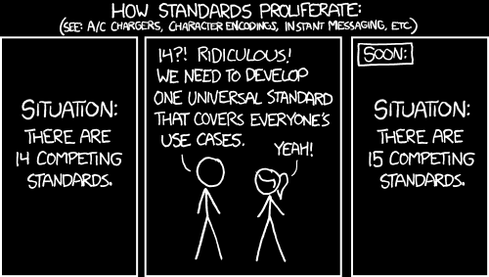
https://xkcd.com/927

Slide 19
.NET Standard: The specification of APIs available on .NET platfoms

Slide 20
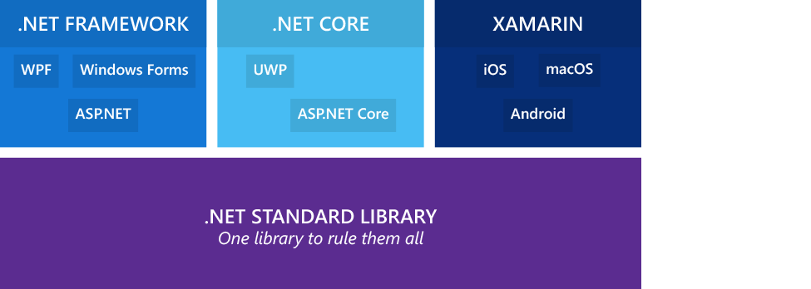
PCL vs .NET Standard

Slide 22
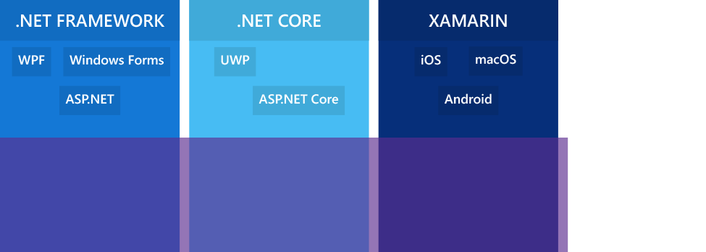

Slide 23
.NET Standard is versioned

Slide 24
interface NetStandard10 {}
interface NetStandard11 : NetStandard10 {}
// ...
interface NetStandard16 : NetStandard15 {}
class NetFramework46 : NetStandard13 {}
class WindowsPhone81 : NetStandard12 {}
class WindowsPhoneSilverlight80 : NetStandard10 {}

Slide 25
PLATFORM | .NET Standard
 | 1.0 | 1.1 | 1.2 | 1.3 | 1.4 | 1.5 | 1.6
.NET Core (on CoreCLR) | → | → | → | → | → | → | 1.0
.NET Framework | → | 4.5 | 4.5.1 | 4.6 | → | → | 4.6.1
Mono | → | → | → | → | → | → | 4.6
Xamarin iOS/Android | → | → | → | → | → | → | 10.0/7.0
Universal Windows Platform | → | → | → | → | 10.0
Windows | → | 8.0 | 8.1
Windows Phone | → | → | 8.1
Windows Phone Silverlight | 8.0
https://docs.microsoft.com/en-us/dotnet/articles/standard/library

Slide 26
.NET Framework and Xamarin work with .NET Standard libraries today

Slide 27
APIs in .NET Standard
Notes:
https://github.com/dotnet/corefx/blob/master/Documentation/architecture/net-platform-standard.md#list-of-net-corefx-apis-and-their-associated-net-platform-standard-version

Slide 28
DEMO
Creating .NET Standard Libraries and NuGet packages

Slide 29
Why bother?

Slide 30
Problems?
API surface area based on .NET Core 1.0 (13500 APIs)
Hard to port existing .NET Framework libraries

Slide 31
.NET Standard
2.0

Slide 32
.NET Standard 1.x Problems
API surface area based on .NET Core 1.0 (13500 APIs)
Hard to port existing .NET Framework libraries

Slide 33
.NET Standard 2.0
almost…
.NET Framework
Xamarin

Slide 34
.NET Standard 2.0 is a strict superset of 1.6
interface NetStandard20 : NetStandard16 {}

Slide 35
~20000 APIs added in 2.0 (32638 vs 13501)

Slide 36
PLATFORM | .NET Standard
 | 1.0 | 1.1 | 1.2 | 1.3 | 1.4 | 1.5 | 1.6
.NET Core (on CoreCLR) | → | → | → | → | → | → | 1.0
.NET Framework | → | 4.5 | 4.5.1 | 4.6 | → | → | 4.6.1
Mono | → | → | → | → | → | → | 4.6
Xamarin iOS/Android | → | → | → | → | → | → | 10.0/7.0
Universal Windows Platform | → | → | → | → | 10.0
Windows | → | 8.0 | 8.1
Windows Phone | → | → | 8.1
Windows Phone Silverlight | 8.0
https://docs.microsoft.com/en-us/dotnet/articles/standard/library

Slide 37
PLATFORM | .NET Standard
 | 1.0 | 1.1 | 1.2 | 1.3 | 1.4 | 1.5 | 1.6 | 2.0
.NET Core (on CoreCLR) | → | → | → | → | → | → | 1.0 | vNext
.NET Framework | → | 4.5 | 4.5.1 | 4.6 | → | → | → | 4.6.1
Mono | → | → | → | → | → | → | 4.6 | vNext
Xamarin iOS/Android | → | → | → | → | → | → | 10.0/7.0 | vNext
Universal Windows Platform | → | → | → | → | 10.0 | → | → | vNext
Windows | → | 8.0 | 8.1
Windows Phone | → | → | 8.1
Windows Phone Silverlight | 8.0
https://docs.microsoft.com/en-us/dotnet/articles/standard/library

Slide 38
Portability shim
We will be able to reference .NET Framework libraries from
.NET Standard 2.0 libraries

Slide 39
When?
With the next version of Visual Studio (Dev15)
TBA, possibly early next year
.NET Core 1.1 – later this year

Slide 40
github.com/dotnet/standard

Slide 41
Adopt 1.x or wait?

Slide 42
TL;DL
.NET Standard is the new PCL
Library authors are using it already
.NET Standard 2.0 will be implemented by .NET Framework, .NET Core, UWP and Xamarin platorms
See github.com/dotnet/standard and follow Immo Landwerth (@terrajobst) for the latest news on .NET

Slide 43
Thank you!
@michaldudak

Slide 44
net.developerdays.pl
@DeveloperDaysPL

Slide 45
Strategic Sponsors
Sponsors and Partners
Gold Sponsors
Silver Sponsors

