Slide 1
Strategic Sponsors
Sponsors and Partners
Gold Sponsors
Silver Sponsors

Slide 2
DDD Where’s the value and what’s in it for me?
Dino Esposito
JetBrains
dino.esposito@jetbrains.com
@despos
facebook.com/naa4e

Slide 3
What does a software architect do?

Slide 4
Design software driven by
the requirements of users
the characteristics of the business domain
the time we have
the money we’ve been told we’ll get

Slide 5
Let’s talk user requirements
Tend to focus on the vision each user has of the system
Tend to blink at technical solutions (usually trivial)
Tend to minimize the number of aspects/features to consider
Constantly incomplete, inaccurate and ambiguous

Slide 6
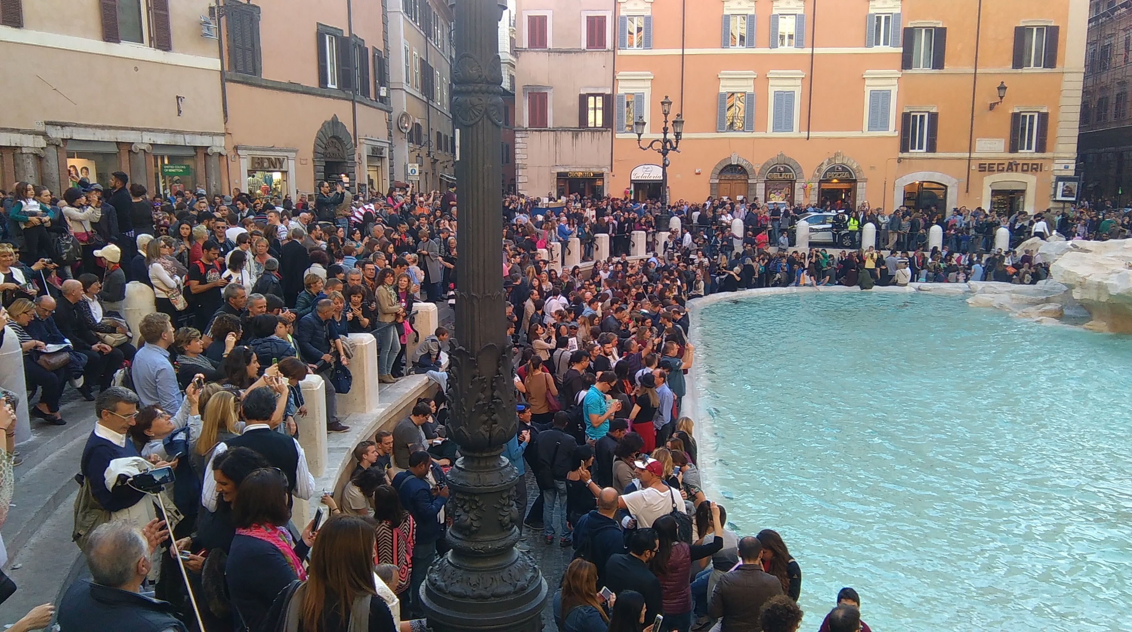
Requirement
Capability the system must have to satisfy a business need

Slide 7
WORDS
REQUIREMENTS
FUNCTIONAL
BUSINESS
FUNCTIONS
Steps to implement
Where you want to go
How you really get there
NON-FUNCTIONAL
CONDITIONS
FEATURES
What you need along the way
Benefits of going there
Cross-cutting concerns

Slide 8
Let’s talk business domain
There are no two identical business domains
A business domain is larger than the system

Slide 9
?

Slide 10
We deliver software that works but not in the way customers like

Slide 11
UX-driven Design in 3 steps
Build up UI forms as users love them
Define workflows from there
Connect workflows to existing biz logic
Sign-off
here

Slide 12
UX-driven Design in 3 steps
Build up UI forms as users love them
QUERY
Define workflows from there
Connect workflows to existing biz logic
COMMAND

Slide 13
After decades of relational programming, the current generation of architects grew up with the obsession of data models.

Slide 14
The obsession of data models brought to creating object models where objects are designed to contain data rather than to expose some behavior.

Slide 15
Get/Set
my properties for free!
Pass data
and I’ll do the rest!
Hello!
I’m an object
Hello!
I implement some behavior

Slide 16
DOMAIN DRIVEN DESIGN is much more serious a thing than just having an object-oriented model for a bunch of business entities

Slide 17
DDD Strategic Design
Ubiquitous Language
Bounded Context
Context Map

Slide 18
SHARED VOCABULARY of TERMS
Nouns and verbs
Referring to key business concepts
Mapping to technical actions
(e.g., cache, security, database)
Domain
experts
Dev
teams

Slide 19
Dynamically Changing Grammar
Vocabulary of valid words (nouns and verbs)
Formal grammar for generating valid expressions out of valid words
Not all verbs can be used with all nouns
Accept an invoice is valid
Accept an order is not valid

Slide 20
When in Rome … do as the Romans do
Delete the booking
Cancel the booking
Submit the order
Checkout
Update the job order
Extend the job order
Create the invoice
Register/Accept the invoice
Set state of the game
Start/Pause the game

Slide 21
Management
Saved to a wiki (or Excel/OneNote)
Each term fully explained, understandable to both domain and software experts
Kept it up-to-date (not a static thing)
Evolve as new insights are gained about the domain
Responsibility of the development team

Slide 22
Ubiquitous ≈ Used Everywhere
User Stories & RFC
Meetings
Emails
Technical Documentation
Schedule
Source code
Source code

Slide 23
Not a freaky new name for
naming conventions.

Slide 24
Problem Space
Solution Space
Domain
Domain Model
Subdomain
Bounded Context
Subdomain
Bounded Context

Slide 25
Splitting a Domain in Contexts
BUSINESS DOMAIN

Slide 26
Bounded Context
Ubiquitous language
Independent implementation
External interface (to other contexts)

Slide 27
You find a bounded context
when the ubiquitous language change.

Slide 28
When the language changes …
A word is discovered to have different meanings or different representations
“Customer” means X to user 1 and Y to user 2
Different users use different words for the same concept User 1 refers to customers as “users”. User 2 refers to customers as “members”
Different users use different “algorithms” for the same task and introduce different entities
User 1 knows about check-in. User 2 doesn’t use any similar concept in the same business domain

Slide 29
Concrete examples of a bounded context
Legacy system
External system
Critical portions to better treat separately

Slide 30
Bounded Context #2
Distinct area of ASP.NET MVC #1
Separate ASP.NET MVC
Web Forms
PHP / HTML
Bounded Context #3
Standalone ASP.NET Web API
BACKOFFICE
Bounded Context #1
ASP.NET MVC
FRONTEND
BIZ RULES
SHOPPING CART
Application logic
Bounded Context #4
Class library
PERSISTENCE
ACCOUNTING
PAYMENT
SHIPPING
Bounded Context #5
Class library
Standalone ASP.NET Web API
PAYMENT
gateway
SHIPPING
gateway
Bounded Context #6
Class library
Standalone ASP.NET Web API
Bounded Context #7
Class library
Standalone ASP.NET Web API

Slide 31
Relationships
Conformist
Downstream context depends on upstream context
No negotiation possible
Customer/Supplier
Customer context depends on supplier context
Chance to raise concerns and have them addressed in some way
Partner
Mutual dependency between the two contexts
Shared Kernel
Shared model that can’t be changed without consulting teams in charge of contexts that depend on it.
Anti-corruption Layer
Additional layer giving the downstream context a fixed interface no matter what happens in the upstream context

Slide 32
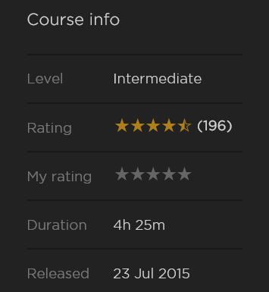
Modern Software Architecture
http://www.pluralsight.com/courses/modern-software-architecture-domain-models-cqrs-event-sourcing
http://naa4e.codeplex.com

Slide 33
net.developerdays.pl
@DeveloperDaysPL

Slide 34
Strategic Sponsors
Sponsors and Partners
Gold Sponsors
Silver Sponsors

