Slide 1
Strategic Sponsors
Sponsors and Partners
Gold Sponsors
Silver Sponsors

Slide 2
C#: Open, evolving, everywhere
Jon Skeet
Notes:
Welcome and introduction

Slide 3
I ❤ C#
Notes:
This is a love story, basically.
It’s a story about me, and C#.
Some bits are specific to me, and I’ve included them because there’s nothing better to satisfy my ego than to listen to the sound of my own voice, talking about me.
That’s what keynotes are for, right?
But the important point is that it’s a story. You’ve got your own story.
The story of C# - like every other language – is a story of many people and relationships.
This is very touchy-feely, but that’s what I want you to come away with – a touchy-feely impression.
Think about your own relationship with the language any other tools you use.
Do you know them well enough to be cheeky to them?
To have playful fun with them in private, but maintain a professional-looking relationship in public?
Does this all sound silly? Show of hands. A relationship with a programming language – honestly!
But how many of you have stickers on your laptops? You have a relationship with that machine… so why not a language?

Slide 4
2000
Notes:
The first beta for C# comes out, and with it a white paper / draft specification (find it!)
C# is apparently a mixture of the best of C++ and VB. Nothing about Java, its obvious closest cousin.
I was interested.
I played a little.
I was dismissive.
This was from Microsoft – a Microsoft that felt pretty negative about, at the time.
I was a Java developer, and thought myself to be a pretty slick one, too.

Slide 5
2002 (or maybe 2001)
Notes:
I started using C# at work.
I started posting on 2001 or 2002.
The seeds of friendship were growing deeper.
Shame it’s Windows only. Shame it’s from Microsoft.
(MVP in 2003.)

Slide 6
2005
Notes:
My one and only MVP summit.
My first blog posts, written on an aeroplane on the way to the summit.
C# 2 is nearly out – but not quite – and C# 3 is available as a plugin for the VS2005 - Whidbey - beta.
First impressions of LINQ, with a plea to the language designers around extension methods…
First meeting with Mads Torgersen in the hallways, after a very brief talk with Anders Hejlsberg (sp?)
Already in pretty deep, now. BFFs.

Slide 7
2007
Notes:
C# in Depth, first edition… (started in 2007, yes? Published 2008)
Imagine you’re writing a biography of your best friend.
You think you know them well already, but oh, the things you learn.
All the imperfections, yes – but a greater appreciation for the art.
And more, the new relationships you can form…
Eric Lippert and his emails written in purple text, and comments with anecdotes and pearls of wisdom dropping everywhere…
VS2008 in November 2007: C# 3 in all its glory… and now we’re way beyond catch-up with Java.
LINQ is beautiful, changing everything.

Slide 8
2008
Notes:
Google and Stack Overflow.
So much to learn, so much to write, so much fun to have.
Some of it with C#, but not all… but that’s okay.
Yes, I was writing Java at work… but my 20% project was C# even then.

Slide 9
2013
Notes:
Look, I was never a massive fan of C# 4.
The dynamic typing is nicely executed, but it’s something I use pretty rarely.
But oh, C# 5.
I gave a talk about what I’d like to see in C# 5 at NDC in Oslo once.
Some of that is sort of in C# 7 and 8… but C# 5 was all about the async.
Yes, I know F# had had async for ages. And yes, I’d like to learn F# properly some day… but it’s not C#.
It’s unlikely to ever have quite the broad appeal of C# - and the broad appeal introduces constraints.
But again, C# is changing the game.

Slide 10
2014
Notes:
Roslyn goes open source.
.NET Core via KVM – remember that?
All open source.
More later, but this is clearly huge.
Wow. Is this the same Microsoft I used to be dismiss?
Oh, and we’re starting to standardize C# 5 in ECMA…
So I’m rereading the C# spec, appreciating just how much I don’t know,
And loving every minute of it. And filing lots of bugs ☺

Slide 11
2015
Notes:
C# 6… leaner, leaner, leaner.
VS powered by Roslyn. This is huge.

Slide 12
What’s for breakfast?
Notes:
So that’s my journey, as far as today.
Small diversion…
Quote from Winnie the Pooh – the end of one of the books, I believe.
“When you wake up in the morning, Pooh," said Piglet at last, "what's the first thing you say to yourself?" "What's for breakfast?" said Pooh. "What do you say, Piglet?" "I say, I wonder what's going to happen exciting today?" said Piglet. Pooh nodded thoughtfully. "It's the same thing," he said.”
So what really excites me today?
We have a lovely language
We have an open source, API-oriented compiler
We have an open source, cross-platform runtime
We have a not-quite-V1 tool chain
We have a not-quite-done C# 7

Slide 13
Open
Notes:
We’re starting to take it for granted, but a huge amount of .NET is now open source
Compiler
Runtime
Toolchains
Dotnet CLI
Powershell
MSBuild
Visual Studio Code
Libraries
Frameworks – not just ASP.NET, but EF as well, both Core and not
“We’ve had that forever”
Not really
Mono being available != .NET being available
ROTOR and the framework source != open source
Microsoft doing Open Source is big.
And it’s not just developed by Microsoft… hundreds of community PRs every month.
This is real Open Source.

Slide 14
Everywhere
Notes:
Ask 5 years ago where .NET is running:
On desktops, primarily for internal apps
On Windows servers, running ASP.NET
What about now?
It runs on this (hold up phone)
It runs on this (hold up iPad)
It runs on goodness knows how many devices running Unity games (and soon .NET 4.6!)
It runs in here…

Slide 15
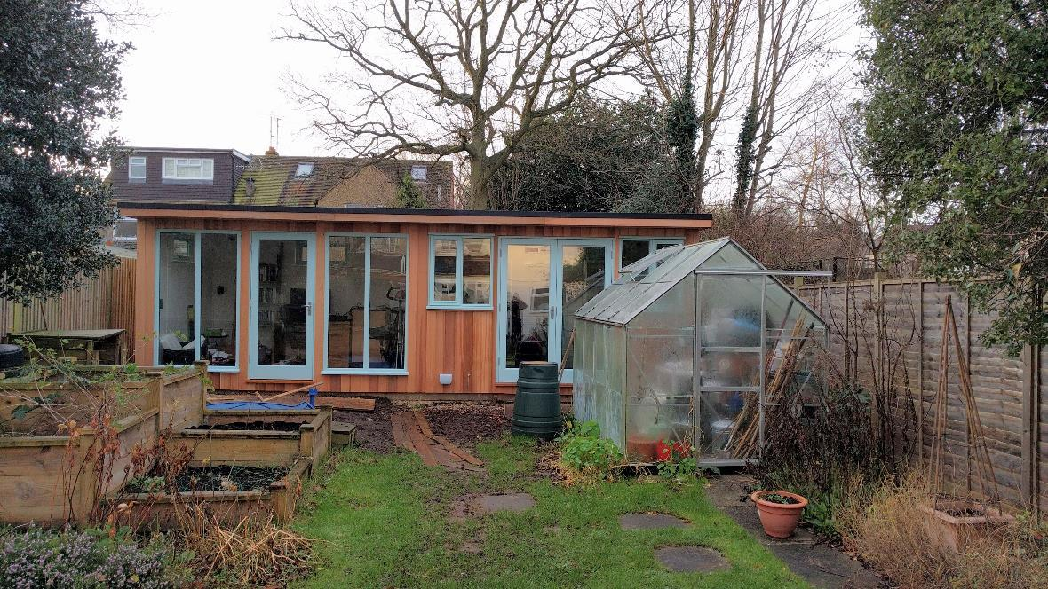
Notes:
This is my shed.
This is where I work, most of the time.
The left part is my home office, the right part is storage for garden equipment.
Now, there’s a problem.
When I’m working from home, I usually get up at 6am and I’m working by 6.30am.
In the summer, that’s fine. In the winter, it’s dark, and the bit of garden before I get to the shed door can get slippery, so I want lights.
Cue my first piece of home automation or advanced remote control: wifi-controlled lights.
I can turn them on with my phone before I go into the garden… but what do I do when I want to turn them off again?
I could use the app on my phone again. But that’s boring, and distracts me from my work.
What if I could run “dotnet run lights off” from a command line?
If I can do that, what else can I do?
Well, I have a surround sound system in the shed, and a Sonos to provide the music… so I can control those from the same app: “dotnet run amp on” etc.
That’s fun, but what’s that got to do with .NET running everywhere? That’s just a command line app.
But it’s a command line app running .NET Core, and the app is separated into the command line driver and the controllers in a separate assembly.
What if we built a UWP application to do all of this, and use speech recognition as the input?
Hooray, I can run it on my laptop. Again, not terribly exciting.
But now I can also run it on a Raspberry Pi 3 wall-mounted in my shed. I can just say “shed lights off” on my way out of the shed, and the lights go off.
In theory – I haven’t done it yet – I can run the exact same app on the Xbox One in my lounge.
And of course if I had a Windows Phone, it should work on that too.

Slide 16
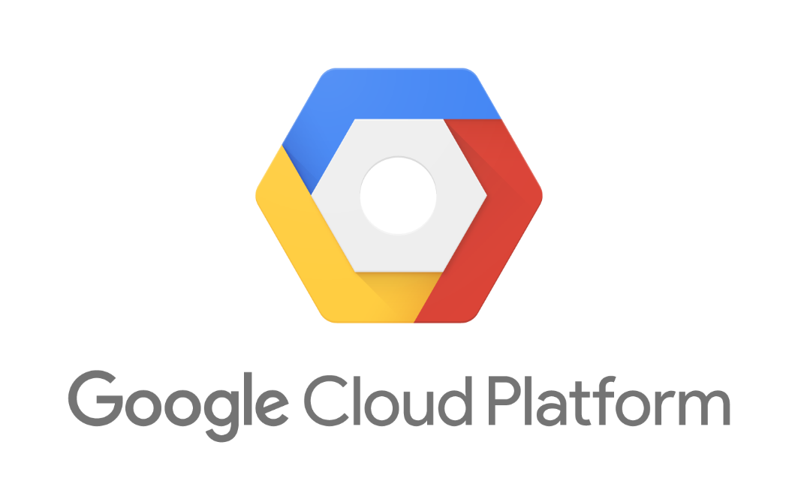
Everywhere
Notes:
That’s fun, but it doesn’t really excite me.
What really excites me is when my work life and my hobbies intersect.
Can you run ASP.NET applications in Azure? Of course, duh.
Can you run ASP.NET Core applications in Azure on Linux? Ooh, yes.
Can you run ASP.NET applications on Google Compute Engine on Windows VMs? Why yes, yes you can.
Can you run ASP.NET Core applications on Google App Engine Flexible Environment? Now we’re cooking – great for a startup!
Can you run ASP.NET Core applications on Kubernetes, such as Google Container Engine? Hell yes. Beautifully orchestrated microservices for the win.
When I joined Google, I had a dream of one day showing up to a conference, and deploying an ASP.NET application to Azure, and then casually flicking a switch and deploying it to AppEngine instead. I expected it would use Mono, if it ever happened, but I never really expected it to happen.
Now, we can just deploy any Linux Docker container – so of course it supports ASP.NET Core.
And you know what’s even better? Both Microsoft and Google get excited about it.
On this week’s ASP.NET Community Standup, the team highlighted a post by Mete Atamel about bringing Kubernetes and ASP.NET Core together.
Chris Sells, my product manager, wrote a blog post in August. The final section started “First and foremost, we’re serious about supporting Windows and .NET workloads on Google Cloud Platform. Second, we’re just getting started.”
Am I excited to be part of this? Oh boy, yes.

Slide 17
Evolving
Notes:
Okay, so a lot of that was about .NET Core… C# just comes along for the ride.
And .NET Core is evolving, certainly – but so is C#.
We have C# 7 in the oven, nearly baked… and the recipe for C# 8 is being put together now.

Slide 18
C# 7
Tuples
Deconstruction
Pattern matching
Local functions
Ref return/local
Custom async factories
Notes:
So what does C# 7 have in store?

Slide 19
C# 8?
Notes:
Who knows? Possibly:
More pattern matching
Non-nullable reference types
Record types (third attempt!)
Async iterators and async foreach
All tracked on Github – go have a look.

Slide 20
Go forth and be awesome
Notes:
Hugely exciting time to be working in C#

Slide 21
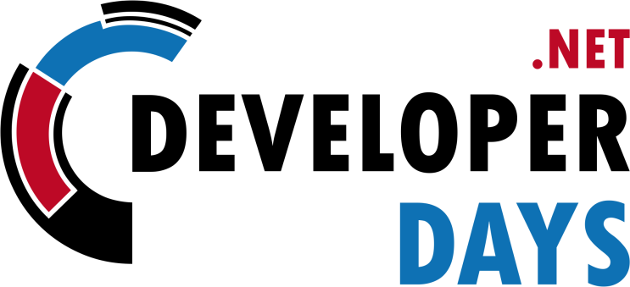
net.developerdays.pl
@DeveloperDaysPL

Slide 22
Strategic Sponsors
Sponsors and Partners
Gold Sponsors
Silver Sponsors

